Slide 1
Fundamental Algorithms II
Linden Lu

Slide 2
Fundamental Algorithms II
K-nearest Neighbors
Support Vector Machine
Random Forest

Slide 3
Module Objectives
By the end of this module, you will be able to:
Understand how the three algorithms work.
Apply the three algorithms with Python code.
Understand the key model hyperparameters.

Slide 4
Introduction to K-nearest Neighbors
Linden Lu

Slide 5
K-nearest Neighbors
Supervised learning
Classification and regression
Predict with class/value of K-nearest neighbors
No model built (memory demanding)
Feature scaling is important

Slide 6
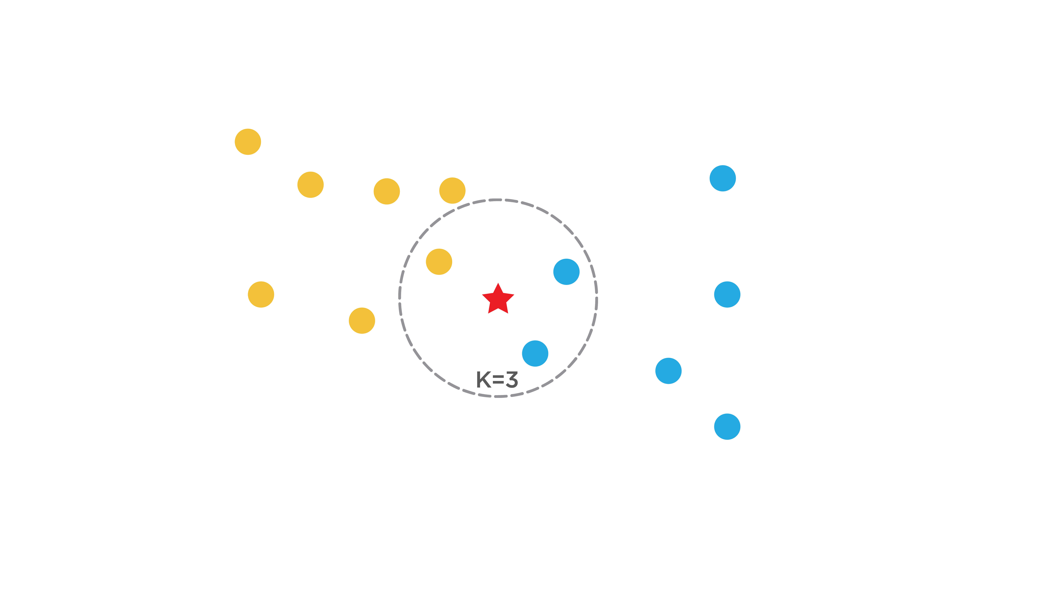
K-nearest Neighbors

Slide 7
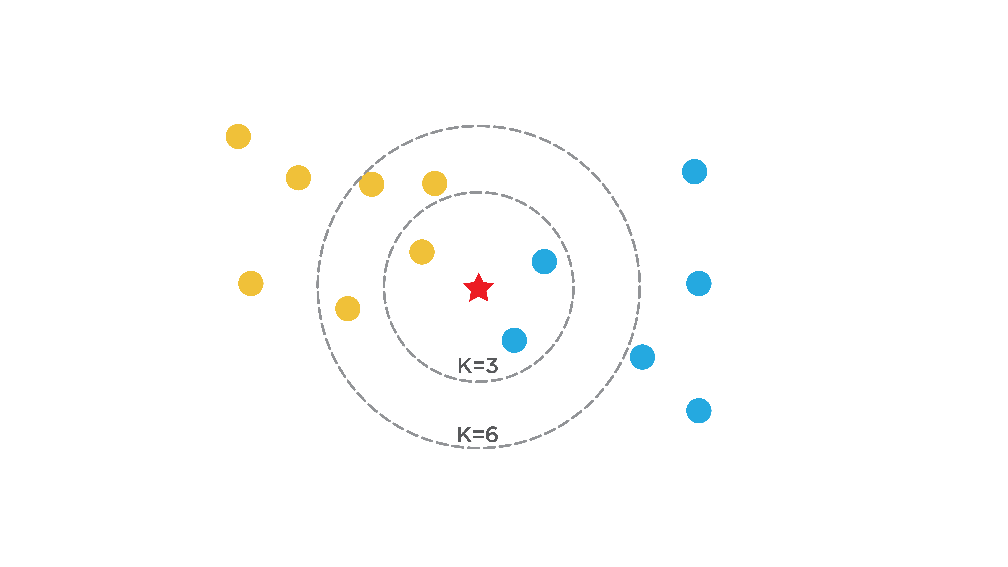
Choose Proper K

Slide 8
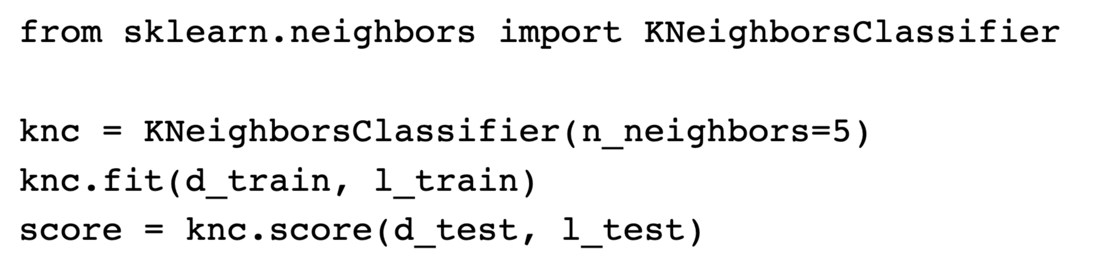
Scikit Learn K-nearest Neighbors Model

Slide 9
Introduction to Support Vector Machine
Linden Lu

Slide 10
Support Vector Machine
Supervised learning
Classification and regression
Performs classification by finding the hyperplane that maximizes the margin between the two classes
Feature scaling is important

Slide 11
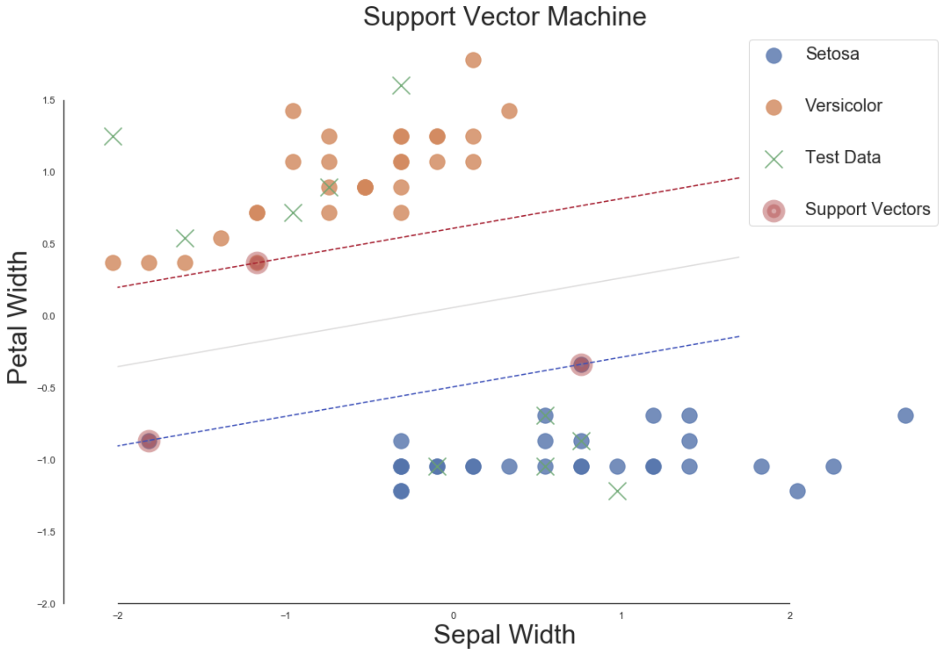
Support Vector Machine

Slide 12
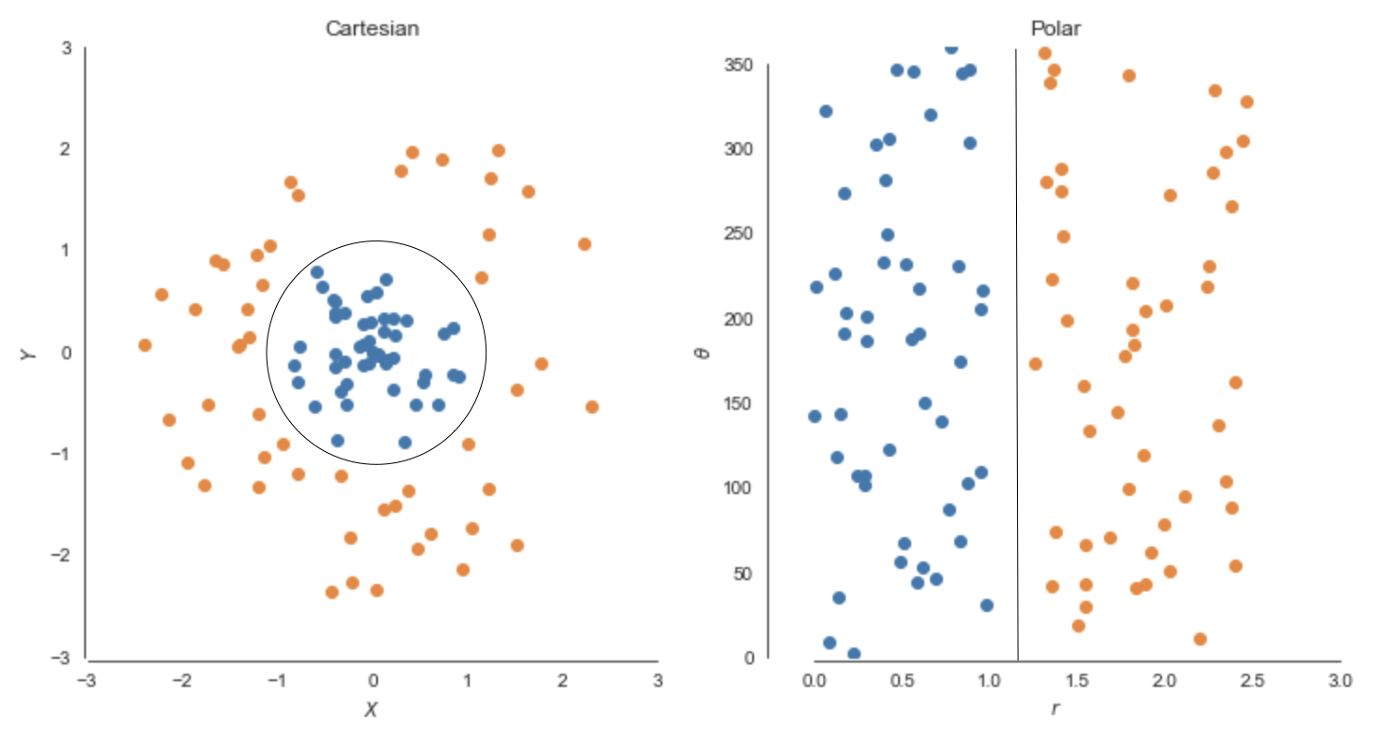
Support Vector Machine Kernel

Slide 13
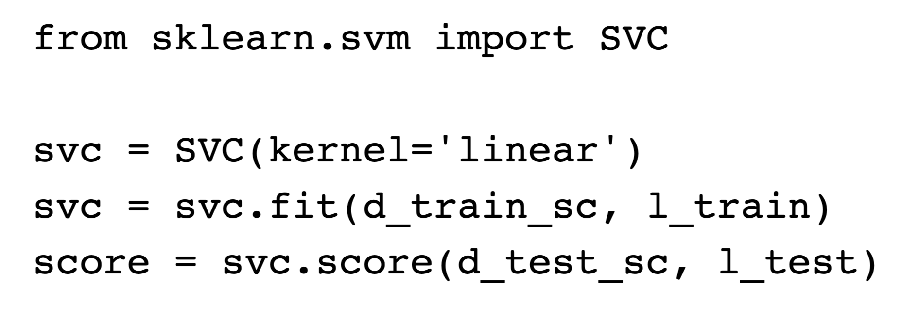
Scikit Learn SVC Model

Slide 14
Introduction to Bagging and Random Forest
Linden Lu

Slide 15
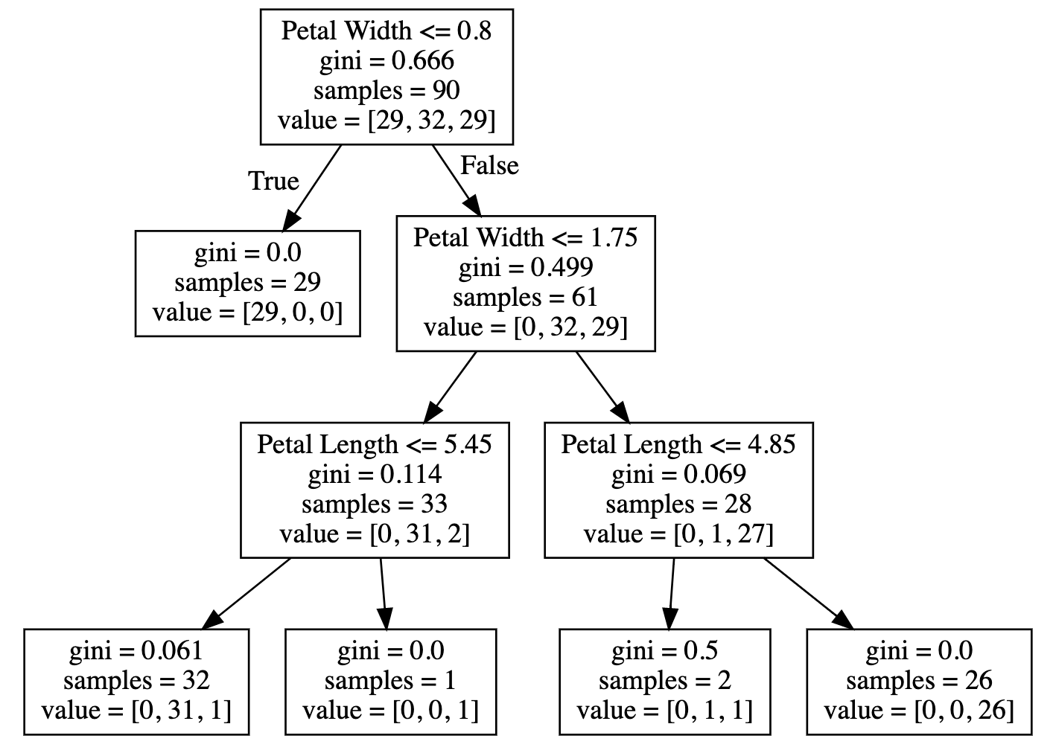
Decision Tree

Slide 16
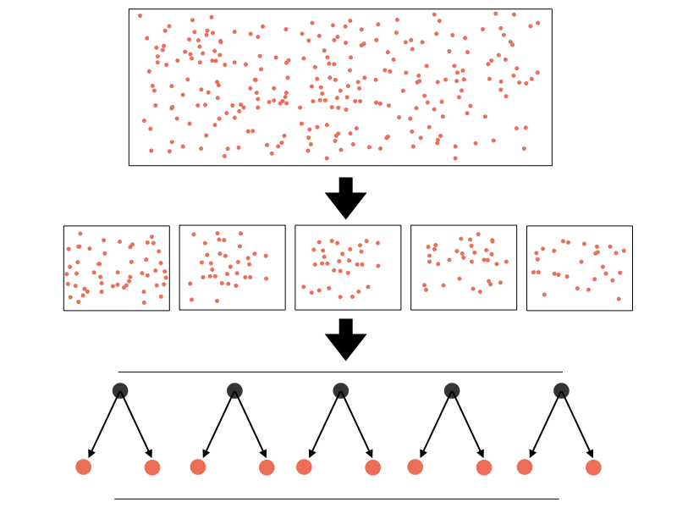
Bagging and Random Forest
Bagging

Slide 17
Random Forest
Supervised learning
For both classification and regression problems
Can handle categorical feature (numerical)
Feature scaling is not needed

Slide 18
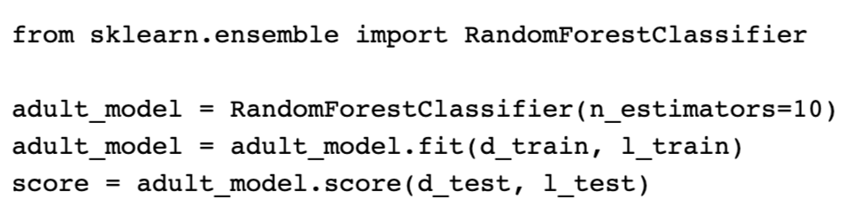
Scikit Learn Random Forest Classifier

